Slide 1
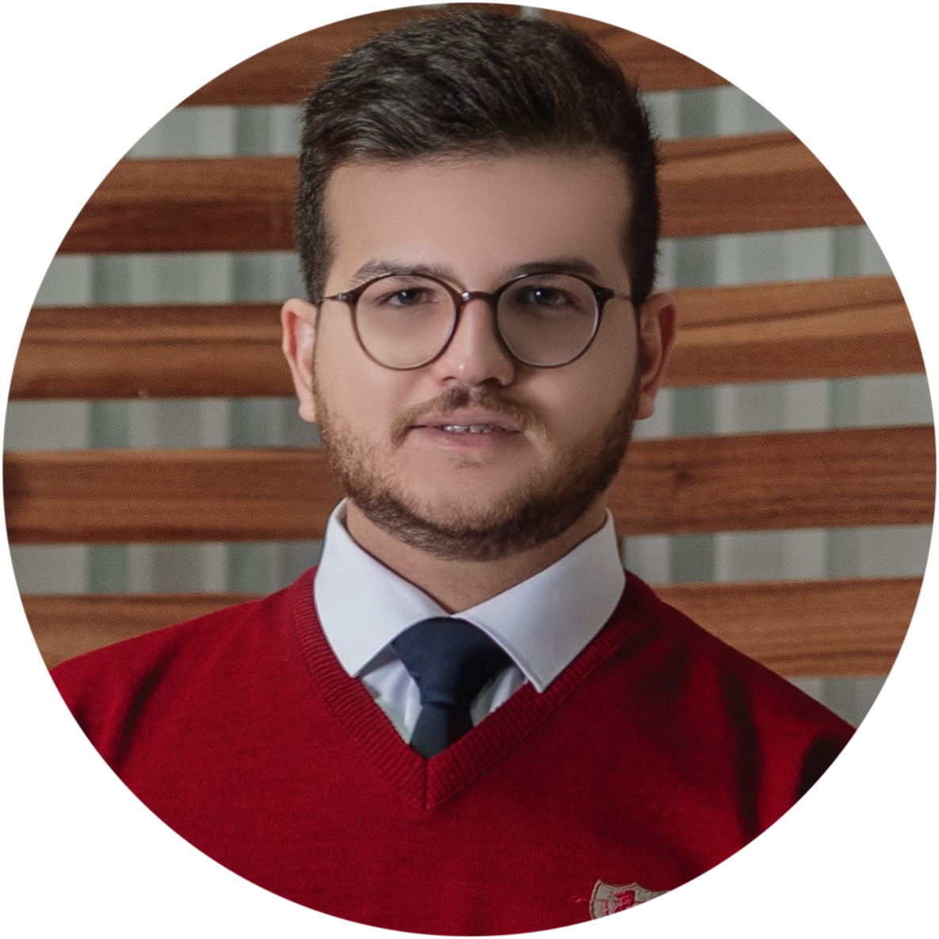



AliReza Shooshtari
ABOUT ME
Date of Birth: May 16th, 1996
Phone: (+98) 9211277974
Address: School of Electrical and Computer Engineering, University of Tehran, Tehran, Iran
A.shooshtari1996@gmail.com
Alireza_shooshtari
Alirezashooshtari
RESEARCH INTERESTS
Deep learning in different biomedical engineering applications
Deep learning in different biomedical engineering applications
Medical image processing
Smart grids
EDUCATION
2019 - 2022
University of Tehran, Iran
MSc., Power Systems
GPA: 17.48 (out of 20)
Thesis: Power Transformer Health Index Modeling Based on Intelligent Methods.
Thesis description: The thesis presents an artificial neural network approach for determining the health index of transformers in a cost-effective manner. The proposed method achieves an accuracy rate of approximately 98% by identifying and removing redundant features while predicting costly cases.
2014 - 2019
Bu-Ali Sina University, Iran
BSc., Electrical engineer
GPA: 17.16 (out of 20)
Thesis: Optimizing Microgrids for Cost Reduction: An Investigation of Production Costs.
Thesis description: This thesis explores optimization methods for microgrids, considering both production costs and maximum utilization.
PUBLICATIONS
Investigation on applications of unsupervised learning methods in clustering the test results of transformers
In simulation stage
TEACHING EXPERIENCES
September 2020 - December 2020
Power Systems Dynamics 1, University of Tehran, Teaching Assistant
Analysis of Power Systems Transients, University of Tehran, Teaching Assistant
Electrical Machines, Bu-Ali Sina University, Teaching Assistant
Industrial Electronics, Bu-Ali Sina University, Teaching Assistant
Fundemtals of Electrical Engineering, Bu-Ali Sina University, Teaching Assistant
Python, Bu-Ali Sina University, Workshop
September 2020 - December 2020
September 2017 - December 2017
September 2017 - December 2017
February 2018 - May 2018
September 2018 - November 2018
SKILLS
Technical:
Deep Learning (supervised Learning, Timeseries Prediction Image Classification, Signal Denoising, Image Denoising, Image Segmentation, Face Detection)
Machine Learning (Supervised Learning, Unsupervised Learning, Timeseries Prediction)
Django Developer (eCommerce Web Developement, RESTful API, Algorithm, Database Programming )
Business intelligence (Data Analyzing, Build Visual Reports )
Tools:
Python (TensorFlow, Scikit-Learn, NumPy, Pandas, OpenCV, Django)
MATLAB (Simulink, Programming)
Microsoft Power BI
MySQL
Microsoft Office (Word, PowerPoint, and Excel)
SOFT SKILLS:
Teamwork
Creative & Design Thinking
Responsibility
Flexibility
LANGUAGE SKILLS
Persian: Native
English: Fluent (IELTS will be taken)

Slide 2

ONLINE COURSES & CERTIFICATIONS
DeepLearning.AI TensorFlow Developer (Coursera):
Introduction to TensorFlow for Artificial Intelligence, Machine Learning, and Deep Learning
Convolutional Neural Networks in TensorFlow
Natural Language Processing in TensorFlow
Sequences, Time Series and Prediction
Deep Learning Specialization (Coursera):
Neural Network and Deep Learning
Improving Deep Neural Networks: Hyperparameter Tuning, Regularization and Optimization
Python for Everybody (Coursera)
Programming with Everybody (Getting Started with Python)
Machine Learning A to Z (UDEMY)
Kaggle
Python
Pandas
Intro to Machine Learning
Intermediate Machine Learning
Feature Engineering
CS50’s Introduction to Computer Science (Harvard University)
Codewithmosh.com
Complete Python Mastery
Complete SQL mastery
The Ultimate Git Course
The Ultimate Django Series
EXPERIENCES
June 2022 - January 2023
INSOOO.ir, Iran: Iranian product search engine that has been in operation since 1997. This platform boasts an extensive database of over 163,452 products.
Backend Developer (Django)
Utilizing sales and inventory data for future planning Through effective database management(MySQL, Power BI)
Python was used to construct a web product monitoring crawler
Full-time
June 2017 - September 2017
Vian Steel Complex (VISCO), Iran: VISCO is Iran’s second largest privately owned steel-maker
Electrical Engineering Internship
Assist in designing and implementing industrial automation systems using Siemens PLCs and devices
Conduct research on new technologies related to industrial automation
Prepare technical reports and documentation related to projects
HONORS & AWARDS
Ranked within top 0.1% among more than 40,000 participations in Iranian university entrance exam for Master’s degree (Rank 35)
Ranked within top 1% among more than 222,000 participations in Iranian university entrance exam for Bachelor’s degree (Rank 1525)
Received national graduate and undergraduate full scholarship
2019
2014
EXTRACURRICULAR ACTIVITIES and Hobbies
2018-2019
Member of the board of directors of “Baran Mehrabani" charity
Supervisor of the education committee at “Baran Mehrabani” charity
Teaching math and Rubik’s cube in low-income areas as a member of the education committee of “Baran Mehrabani” charity
2017-2018
2017-2018
Hobbies
Movie
Soccer
REFERENCES
Studying philosophy, astronomy, and physics
Dr. Amir Abbas Shayegani Akmal
Assistant Professor
School of Electrical and Computer Engineering
University of Tehran, Iran
shayegani@ut.ac.ir
Dr. Mohamad Amin Ghasemi
Assistant Professor
Department of Electrical and Computer Engineering
Bu-Ali Sina University. Iran
ma.ghasemi@basu.ac.ir
Dr. Mohammad H. Moradi
Professor
Department of Electrical and Computer Engineering
Bu-Ali Sina University. Iran
mhmoradi@basu.ac.ir

